Slide 1

ACADEMIC LANGUAGE

Slide 2
What is Academic English?
Academic English refers to a specialised form of communication used within the realm of academia, characterized by precise language, structured organization, and a focus on critical thinking.
It is the language employed by scholars, researchers, and students to convey complex ideas, research findings, and arguments within various academic disciplines.
This form of writing and communication is essential for participating in scholarly discourse and contributing to the advancement of knowledge within a specific field.

Slide 3
Critical Perspective on Academic English
From a critical standpoint, some scholars argue that the conventions of Academic English can present barriers to accessibility and inclusivity.
The formal and often rigid structure of academic writing may distance certain audiences, making valuable research and knowledge less accessible to those outside academia or from diverse linguistic backgrounds.
Additionally, the emphasis on conforming to specific style guides, such as the Harvard referencing style, can inadvertently privilege certain types of knowledge production and sources, potentially marginalizing alternative voices and perspectives.

Slide 4
BRITISH VS AMERICAN ENGLISH
Introduction to British English
Introduction to American English
British English is the collection of dialects and accents of the English language used in the United Kingdom and its former colonies.
It has a rich history and has evolved over centuries, influenced by various factors such as geography, social classes, and contact with other languages.
American English is the variety of the English language spoken in the United States and various other countries where American influence is strong.
It has been influenced by various languages, including Native American languages, Spanish, and French.

Slide 5
Key Features of American English
Pronunciation:
Diverse accents across regions, such as Southern accent, New York accent, and Midwestern accent.
Rhotic accent, where the "r" sound is pronounced at the end of words like "car."
Vocabulary:
Different terms, like "truck" instead of "lorry," "apartment" instead of "flat," "flashlight" instead of "torch."
Unique names for specific items, e.g., "elevator" instead of "lift," "diaper" instead of "nappy."
Spelling:
American English uses "o" instead of "ou" in words like "color" and "favor."
Words ending in "er" instead of "re," such as "center" and "meter."
Grammar:
More common use of simple past tense, e.g., "I just ate."
Different prepositions and expressions, e.g., "on the weekend" instead of "at the weekend."
Idioms and Expressions:
"Piece of cake" - Something is very easy.
"Hit the hay" - Go to bed.

Slide 6
Key Features of British English
Pronunciation:
Received Pronunciation (RP), often referred to as the "Queen's English," is a prestigious accent associated with educated speakers.
Varieties of regional accents like Cockney (East London), Scouse (Liverpool), Geordie (Newcastle), and more.
Vocabulary:
Some unique terms like "lorry" for "truck," "flat" for "apartment," "boot" for "trunk," and "biscuit" for "cookie."
Different names for the same object, e.g., "lift" for "elevator," "torch" for "flashlight."
Spelling:
British English tends to use "ou" instead of "o" in words like "colour" and "favour."
Words ending in "re" instead of "er," such as "centre" and "metre."
Grammar:
Use of the present perfect tense more frequently, as in "I have just eaten."
Different prepositions and expressions, e.g., "at the weekend" instead of "on the weekend."
Idioms and Expressions:
"Bob's your uncle" - Everything is all set.
"It's raining cats and dogs" - Heavy rain.

Slide 7
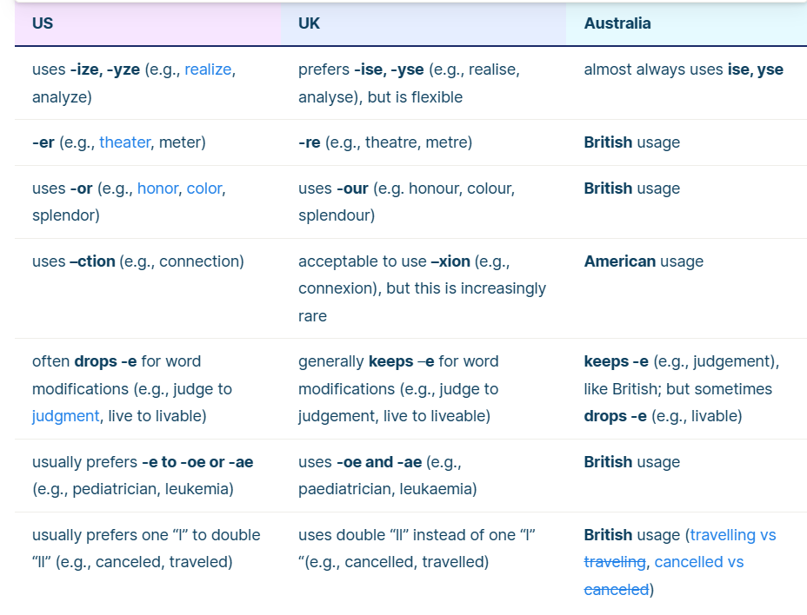
SPELLING

Slide 8
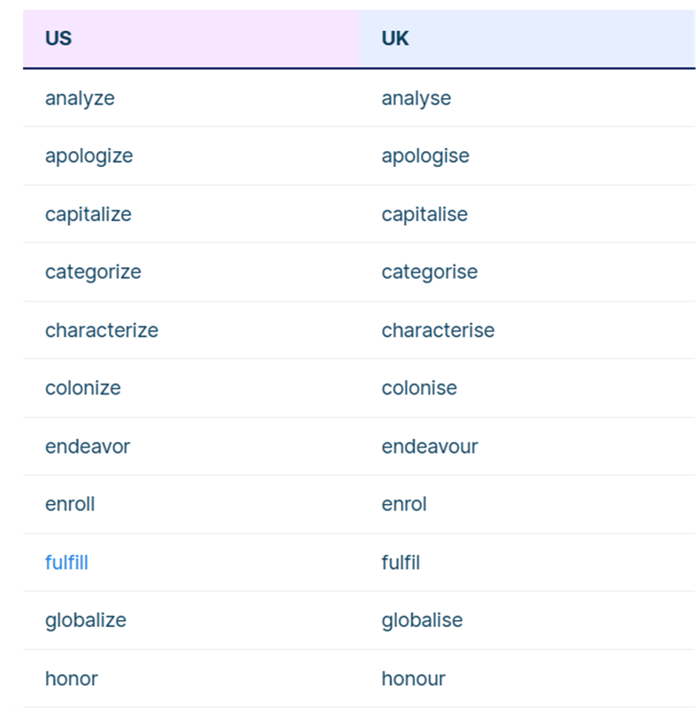
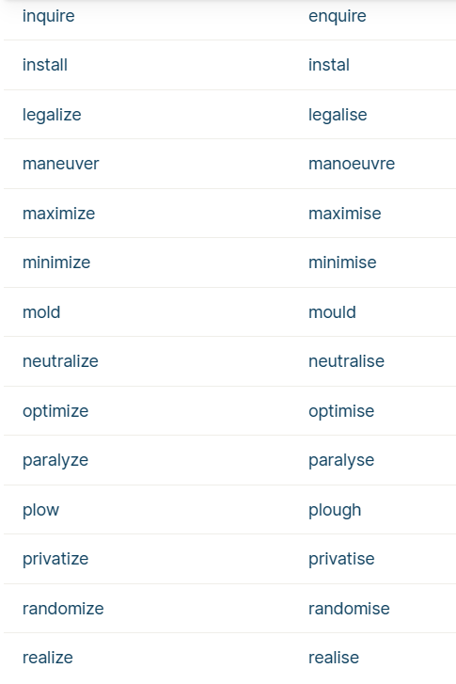
VERBS

Slide 9
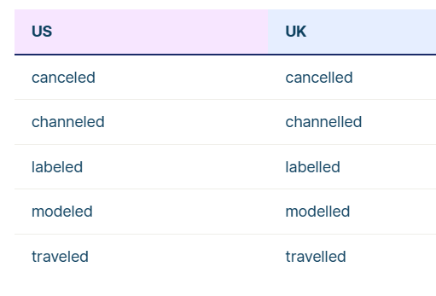
PAST TENSE OF VERBS

Slide 10
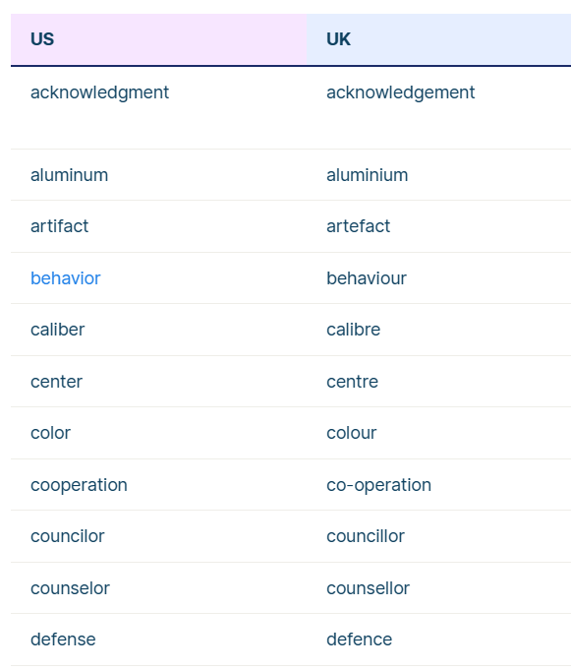
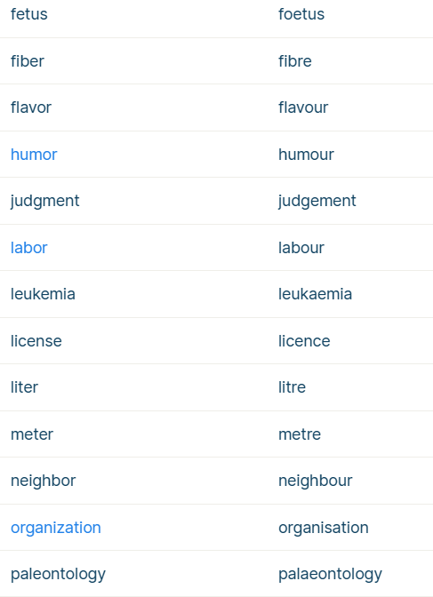
NOUNS

Slide 11
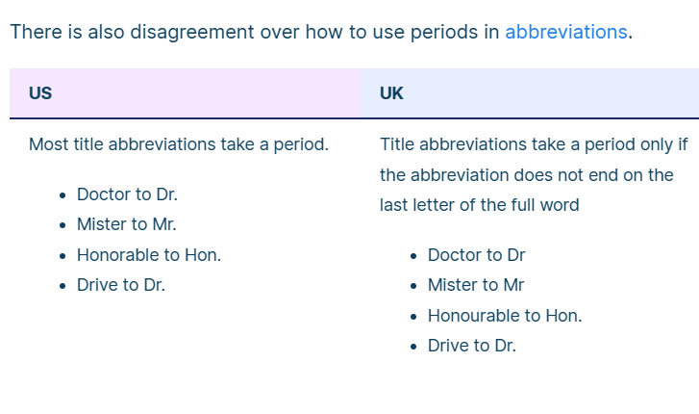
US VS UK ABBREVIATIONS

Slide 12
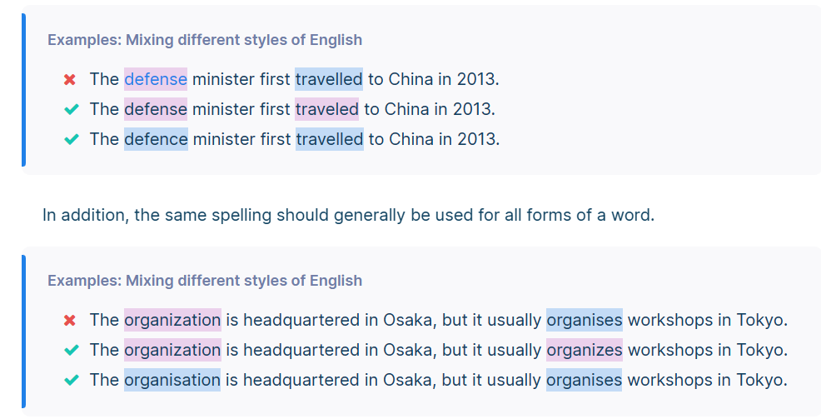
Consistency is key
Avoid mixing US English and UK English

Slide 13

Punctuation
Refer to the Punctuation Style Guide uploaded for your reference

Slide 14

References
Scribbr. (n.d.). UK vs. US English Archieven. [online] Available at: https://www.scribbr.com/category/us-vs-uk/.
‌Style Guide. (2016). Available at: https://www.ox.ac.uk/sites/files/oxford/Style%20Guide%20HT2016.pdf [Accessed 18 Aug. 2023].

